Slide 1
Software Engineering Concepts (CSC-205) BS(SE)/BS(SE)- IIIgg
Lecture 2

Slide 2
Agenda
SE: Def
SE:Objectives
Layered Technology
Process vs. Product based

Slide 3
What is Software?
Software
Programs
Documentation
Data
System Documentation
User Documentation

Slide 4
Common issues
The final Software doesn´t fulfill the needs of the customer.
Hard to extend and improve: if you want to add a functionality later is mission impossible.
Bad documentation.
Bad quality: frequent errors, hard to use, ...
More time and costs than expected

Slide 5
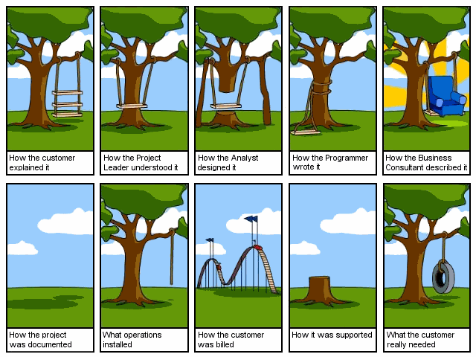
Notes:
i. The final Software doesn´t fit the needs of the customer
ii. Hard to extend and improve: if you want to add a functionality later is mission impossible
Bad documentation, bad software design
iii. Bad quality: frequent errors, hard to use...
iv. More time and costs than expected

Slide 6
But
That never happens,
right?

Slide 7
Wrong!

Slide 8
Problems in Software
Development

Slide 9
Limitations of Non-engineered Software
Requirements
Here is the problem!!
Software
Notes:
One of the problems with complex system design is that you cannot foresee the requirements at the beginning of the project. In many cases, where you think you can start with a set of requirements, that specifies the completely the properties of your system you end up with....

Slide 10
Software Production has a Poor Track Record Example: Space Shuttle Software
Cost: $10 Billion, millions of dollars more than planned
Time: 3 years late
Quality: First launch of Columbia was cancelled because of a synchronization problem with the Shuttle's 5 onboard computers.
Error was traced back to a change made 2 years earlier when a programmer changed a delay factor in an interrupt handler from 50 to 80 milliseconds.
The likelihood of the error was small enough, that the error caused no harm during thousands of hours of testing.

Slide 11
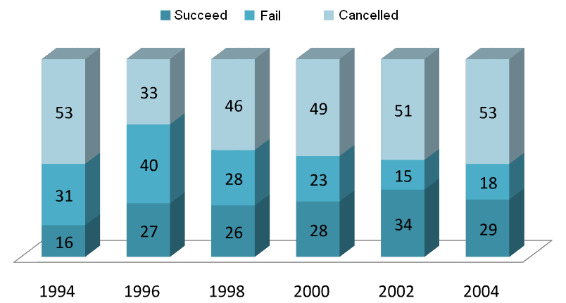
Chaos Report
Notes:
Coming back to the Chaos Report 2006, the thing that doesn’t change significantly over all those years is percentage of projects with time or budget overrun. It still oscillates around 50%

Slide 12
Conclusion
Programming is NOT enough!
It is not enough to do your best: you must
Know what to do, and THEN do your best.
-- W. Edwards Deming

Slide 13
And Since…
A clever person solves a problem. A wise person avoids it.
- Albert Einstein

Slide 14
Solution

Slide 15
Software Engineering
Notes:
In simple terms, is the study and application of methodologies to develop quality software that fulfill customer needs.

Slide 16
Engineering
Engineering is a scientific field that involves taking our scientific understanding of the natural world and using it to invent, Design, and Build things to solve problems and achieve practical solutions.

Slide 17
Software Engineering
What is it?
The application of a systematic, disciplined, quantifiable approach to the development, operation, and maintenance of software, and the study of these approaches; that is, the application of engineering to software.
-IEEE
Notes:
In simple terms, is the study and application of methodologies to develop quality software that fulfill customer needs.

Slide 18
Software Engineering
“A systematic approach to the analysis, design, implementation and maintenance of software.”
(The Free On-Line Dictionary of Computing)
“ The systematic application of tools and techniques in the development of computer-based applications.”
(Sue Conger in The New Software Engineering)
“ Software Engineering is about designing and developing high-quality software.”
(Shari Lawrence Pfleeger in Software Engineering -- The Production of Quality Software)

Slide 19
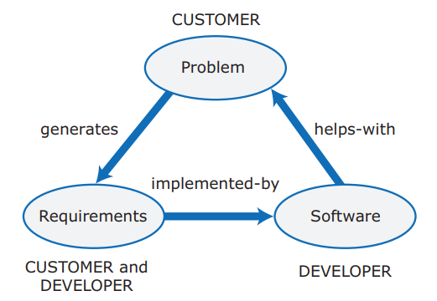
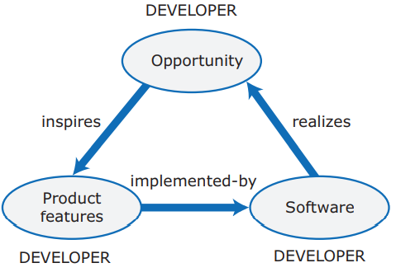
Project-based software engineering
Product-based software engineering

Slide 20
Software Engineering: A Problem-Solving Activity
Analysis: Understand the nature of the problem and break the problem into pieces
Synthesis: Put the pieces together into a large structure
For problem solving we use
Techniques (methods):
Formal procedures for producing results using some well-defined notation
Methodologies:
Collection of techniques applied across software development and unified by a philosophical approach
Tools:
Instrument or automated systems to accomplish a technique
Isn’t there something more fundamental than problem “solving”?

Slide 21
Why Software Engineering?
Major Goals:
- To increase software productivity and quality.
- To effectively control software schedule and planning.
- To reduce the cost of software development.
- To meet the customers’ needs and requirements.
- To enhance the conduction of software engineering process.
- To improve the current software engineering practice.
- To support the engineers’ activities in a systematic and efficient manner.

Slide 22
A Layered Technology
Software Engineering
tools
methods
process model
a “quality” focus

Slide 23
Software Engineering
A Layered Technology
Any engineering approach must rest on organizational commitment to quality which fosters a continuous process improvement culture.
Process layer as the foundation defines a framework with activities for effective delivery of software engineering technology. Establish the context where products (model, data, report, and forms) are produced, milestone are established, quality is ensured and change is managed.
Method provides technical how-to’s for building software. It encompasses many tasks including communication, requirement analysis, design modeling, program construction, testing and support.
Tools provide automated or semi-automated support for the process and methods.

Slide 24
A Software Engineering Framework
A quality focus
Any engineering approach must rest on organizational commitment to quality which fosters a continuous process improvement culture.
Process layer
The foundation for software engineering is the process layer
Deﬁnes a framework that must be established for effective delivery of software engineering technology
Establish a context where
Products (model, data, report, and forms) are produced
Milestones are established
Quality is ensured
Change is managed

Slide 25
A Software Engineering Framework
Methods
Provide the technical how-to for building software
Methods encompass a broad array of tasks
Communication , requirements analysis, design modeling, program construction, testing, and support
Tools
Provide automated or semi-automated support for the process and the methods
Integrated tools to support software development
Called computer aided software engineering

Slide 26
Stages for Software Development
Requirements Analysis
Software Design
Implementation
Testing
Maintenance

Slide 27
SW Eng. vs. System Eng.
Systems Engineering:
Interdisciplinary engineering field (computer, software, and process eng.).
Focuses on how complex engineering projects should be designed and managed.
Systems Engineering
All aspects of computer-based systems development: HW + SW + Process.
Software Engineering
Deals with the design, development and delivery of SW.
Older than SWE.
Is part of Systems Engineering.

